Slide 1

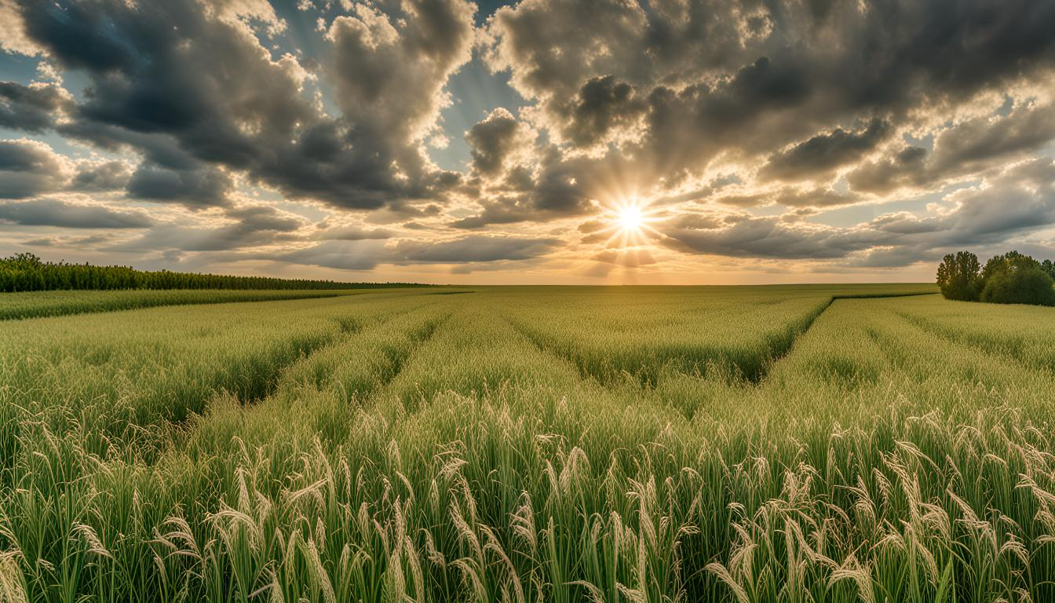
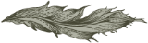
Performance of Oats in Manitoba (2004-2023)
Yadwinder Singh Banwait​

Slide 2
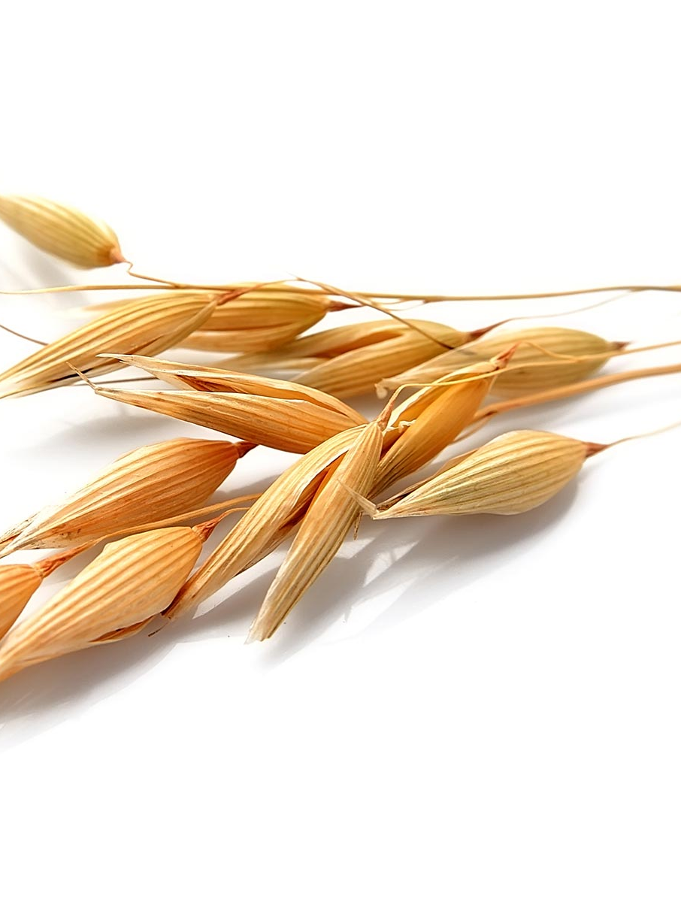
PROBLEM STATEMENT
Can we find the reason behind
increasing yield performance of
Oats.
It can help in decision making related to oats crop variety selection.

Slide 3
DATA COLLECTION AND PREPROCESSING
Manitoba Crop Yields Varieties: https://masc.mb.ca/masc.nsf/mmpp_browser_variety.html
Geographical Boundaries of Manitoba Rural Municipalities: https://geoportal.gov.mb.ca/datasets/8b64285c3bf6445a8d0d8ea4a1c43849/explore?location=53.584348%2C-97.779011%2C6.81
Crop Yields from 2004-2023
Crops included in data analysis: Argentine Canola, Barley, Field Peas, Oats, Red Spring Wheat.
All yields are in Bushels
Dropped unnecessary columns and formatted data for further processing.

Slide 4
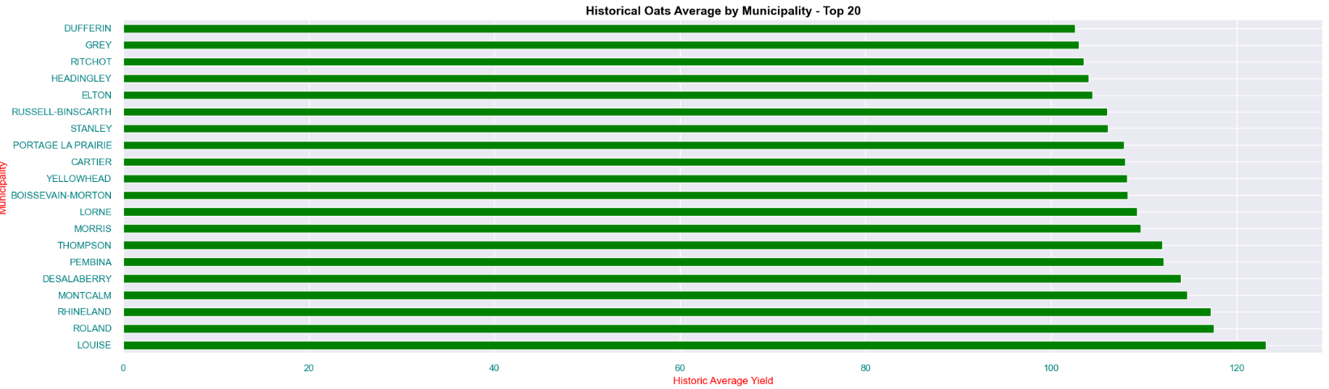
EXPLORATORY DATA ANALYSIS

Slide 5
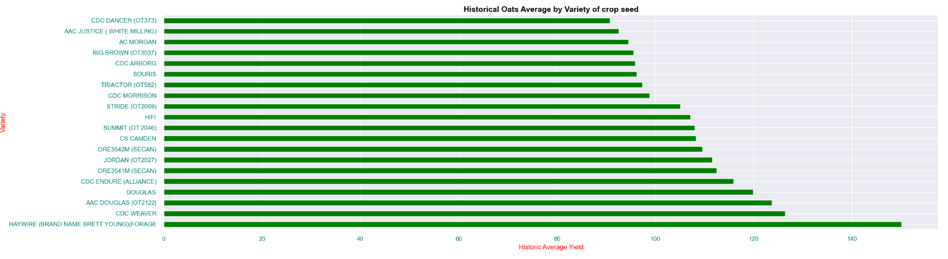
EXPLORATORY DATA ANALYSIS

Slide 6
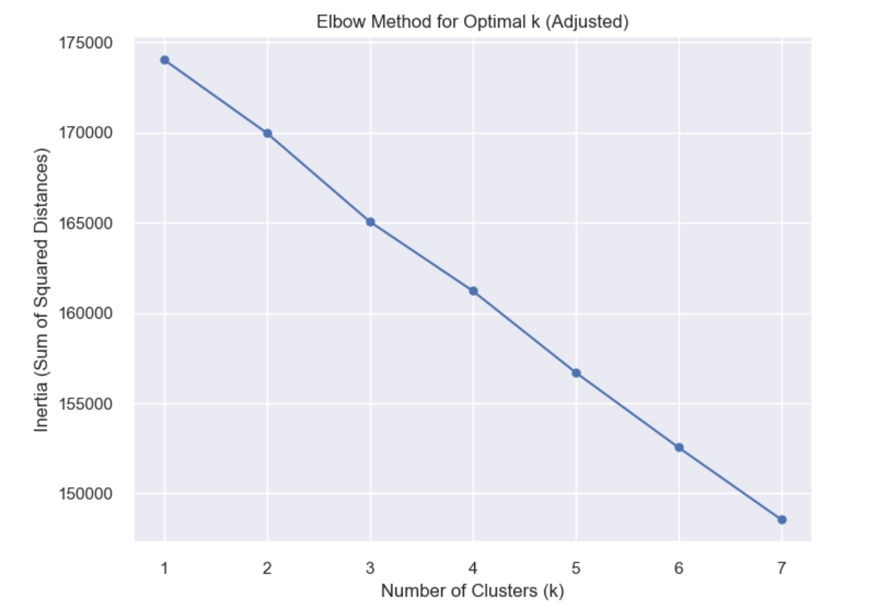
UNSUPERVISED MACHINE LEARNING K-MEANS CLUSTERING

Slide 7
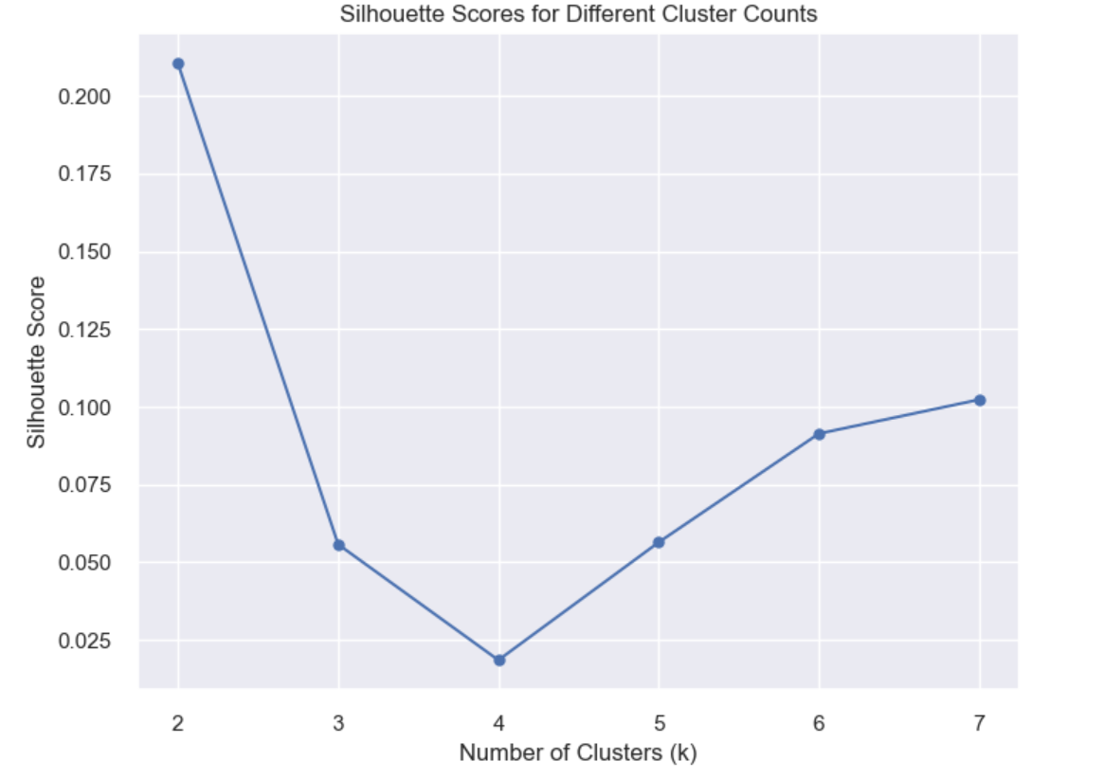
UNSUPERVISED MACHINE LEARNING K-MEANS CLUSTERING

Slide 8
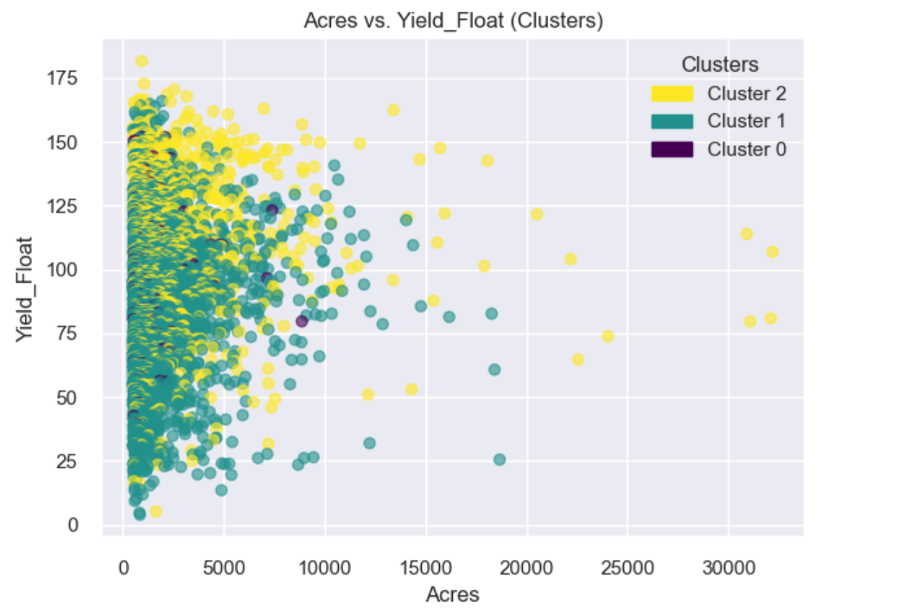
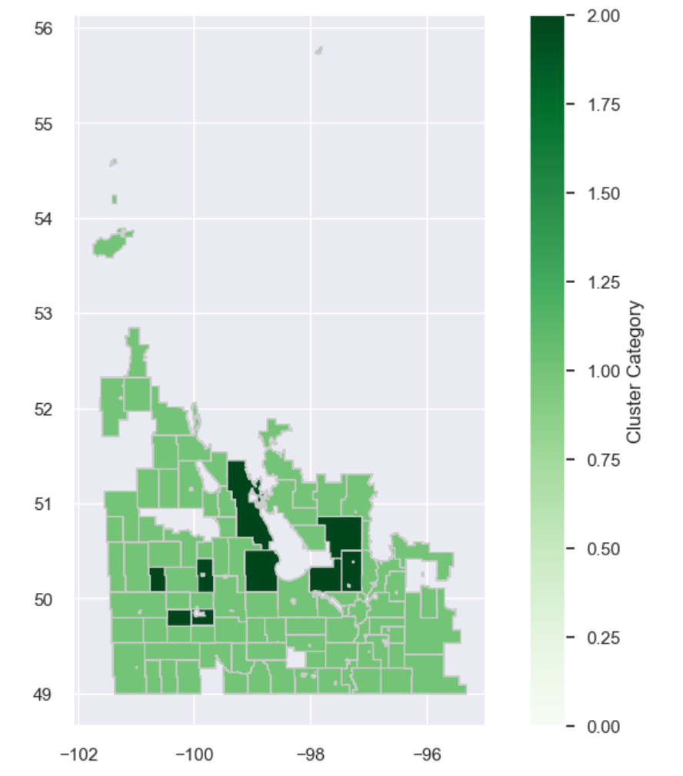
UNSUPERVISED MACHINE LEARNING K-MEANS CLUSTERING

Slide 9
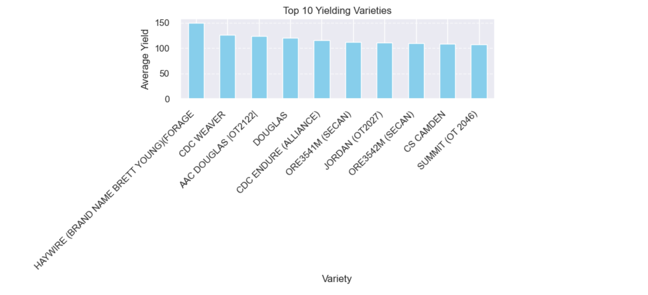
DATA ANALYSIS: CONCLUSION & FUTURE ANALYSIS
We concentrate on Top yielding cluster:
Top yielding farms belong to cluster 2.
Cluster 2 farms are large farms.
Top yielding variety is Haywire (Brand name Brett Young)(Forage)
Cluster 2 farms mostly used variety Haywire (Brand name Brett Young)(Forage).
Further analysis can be done to know about other factors affecting the yield of oats (Weather, soil).

Slide 10

Thank you

